Slide 1
Learning Objective
CFU
What will we learn today?
I will be able to rearrange formulas
CFU
How will you know that you are successful?
Success Criteria
At the end of the lesson, I will be able to:
Rearrange formulas to make a different variable the subject of the formula

Slide 2
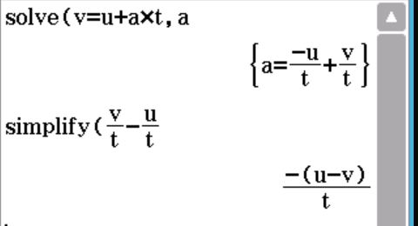







Guided Practice
Find the area of a rectangle with length $l 10 cm$ and width $w 4 cm$.
$$A=lw$$
$$A=10×4$$
$$A=40 {cm}^{2}$$
Transpose the formula $v=u+at$ to make $a$ the subject.
$$v=u+at$$
$$v−u=at$$
$$at=v−u$$
$$a=\frac{v−u}{t}$$

Slide 3
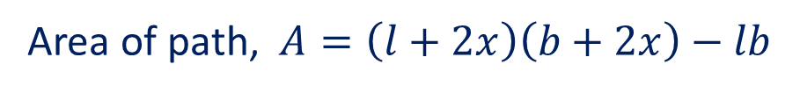

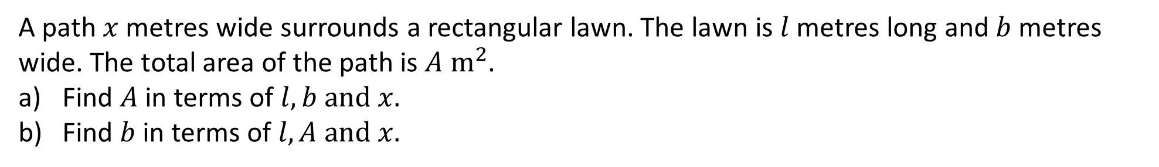
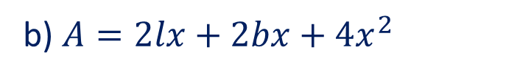

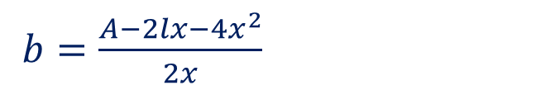

Guided Practice
A path $x$ metres wide surrounds a rectangular lawn. The lawn is $l$ metres long and $b$ metres wide. The total area of the path is $A m^{2}$.
Find $A$ in terms of $l,b and x.$
Find $b$ in terms of $l, A and x.$
a) Area of lawn =$lb$
Area of path, $A=\left(l+2x\right)\left(b+2x\right)−lb$
$$A=lb+2lx+2bx+4x^{2}−lb$$
$$A=2lx+2bx+4x^{2}$$
b) $A=2lx+2bx+4x^{2}$
$A−2lx−4x^{2}=2bx$
$b=\frac{A−2lx−4x^{2}}{2x}$

Slide 4

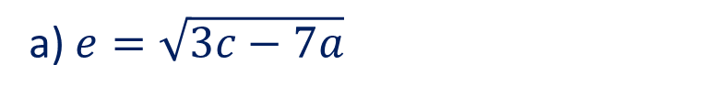
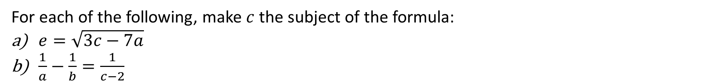
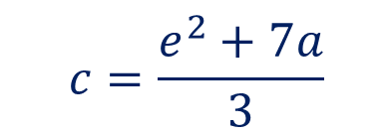


Guided Practice
For each of the following, make $c$ the subject of the formula:
$e=\sqrt{3c−7a}$
$\frac{1}{a}−\frac{1}{b}=\frac{1}{c−2}$
a) $e=\sqrt{3c−7a}$
$$e^{2}=3c−7a$$
$$e^{2}+7a=3c$$
$$3c=e^{2}+7a$$
$$c=\frac{e^{2}+7a}{3}$$

Slide 5

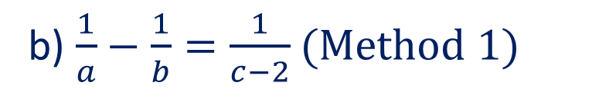






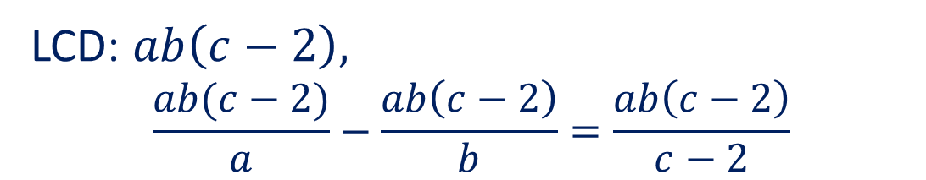

Guided Practice
For each of the following, make $c$ the subject of the formula:
$e=\sqrt{3c−7a}$
$\frac{1}{a}−\frac{1}{b}=\frac{1}{c−2}$
b) $\frac{1}{a}−\frac{1}{b}=\frac{1}{c−2}$ (Method 1)
LCD: $ab\left(c−2\right),$
$$\frac{ab(c−2)}{a}−\frac{ab\left(c−2\right)}{b}=\frac{ab\left(c−2\right)}{c−2}$$
$$b\left(c−2\right)−a\left(c−2\right)=ab$$
$$bc−2b−ac+2a=ab$$
$$bc−ac=ab+2b−2a$$
$$c(b−a)=ab+2b−2a$$
$$c=\frac{ab+2b−2a}{b−a}$$
$$c=\frac{ab}{b−a}+\frac{2(b−a)}{b−a}$$
$$c=\frac{ab}{b−a}+2$$
$$c=\frac{ab+2(b−a)}{b−a}$$

Slide 6
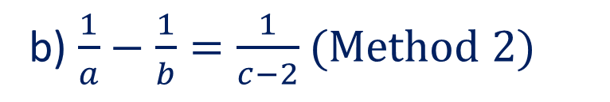




Guided Practice
For each of the following, make $c$ the subject of the formula:
$e=\sqrt{3c−7a}$
$\frac{1}{a}−\frac{1}{b}=\frac{1}{c−2}$
b) $\frac{1}{a}−\frac{1}{b}=\frac{1}{c−2}$ (Method 2)
Convert LHS to LCD
$$\frac{b}{ab}−\frac{a}{ab}=\frac{1}{c−2}$$
$$\frac{b−a}{ab}=\frac{1}{c−2}$$
Take the reciprocal of both sides , $\frac{ab}{b−a}=c−2$
$$c=\frac{ab}{b−a}+2$$

Slide 7
Independent Practice
Complete Ex 1F

